Slide 1

SNIPE TEAM
9 December 2017
www.snipe.co.in
1
Notes:
1

Slide 2



GIT
GitHub

Slide 3
CONTENTS
INTRODUCTION TO GIT
HISTORY OF GIT
VERSION CONTROL SYSTEM
GETTING STARTED TO GIT
BRANCHING
MERGING & REBASE
Intro To GitHub
Installation of Git
Tools for Git
Git Commands
Steps to create a repo
Example
SUMMARY

Slide 4
INTRO TO GIT
GIT is a Distributed Version Control System.
It is a content addressable file system, used to track directory trees.
It handles all the things like merging of source code and maintaining versions.
GIT is optimized for Complex Merges and Fast.
It follows Trunk Base Development.
It allows for code collaboration with anyone online.
Users keep entire code and history on their location machines
Users can make any changes without internet access

Slide 5

GIT HISTORY
Linus uses BitKeeper to manage Linux code
In 2005, BitKeeper suddenly became unavailable.
Linus decided to create a tool with Distributed Source Management System.
Linus Torvalds developed GIT in June 2005.
Founder

Slide 6
Terminology
DIRECTORY : A folder is used for storing multiple files.
REPOSITORY : A collection of all the files and their history organized in folders, branches, tags.
CLONE : Act of copying a repository from a remote server.
BRANCH : It is a pointer to a commit(save the files).
MERGE : Combination of one or more branches into the current branch.
ORIGIN : The default name of the remote repository.

Slide 7
Terminology
MASTER : It is just another branch, but is the default one which gets created.
STAGE FILES : These are the files we have told GIT that are ready to committed.
SNAPSHOT : In general is just the "entity" that GIT uses to store its data.
INTEGRATORS : It can review and bring changes to reference code asynchronously to central repository.

Slide 8
Version Control System
Version Control System (VCS) is a software that helps software developers to work together and maintain a complete history of their work.
Version Control, also known as Revision Control or Source Control.
Functions of a Version Control System :
Allows developers to work simultaneously.
Maintains a history of every version.
Does not allow overwriting each other’s changes.
Following are the types of Version Control System :
Centralized version control system (CVCS).
Distributed/Decentralized version control system (DVCS).

Slide 9
CENTRALIZED VERSION CONTROL SYSTEM
Centralized version control system (CVCS) uses a central server to store all files and enables team collaboration.
“Committing” a change simply means recording the change in the central system and Other programmers can then see this change.
They can also pull down the change, and the version control tool will automatically update the contents of any files that were changed.
It is a Client-Server approach.

Slide 10
CVCS WORKFLOW
When you’re working with a Centralized Version Control System, your workflow for adding a new feature or fixing a bug in your project will usually look something like this:
Pull down any changes other people have made from the central server.
Make your changes, and make sure they work properly.
Commit your changes to the central server, so other programmers can see them.

Slide 11
DEMERITS
Merging of files or code is difficult.
A single point of failure i.e., failure of the central server.
Remote Server commits slow while transferring data.
Unsolicited changes that may break your project.

Slide 12
DISTRIBUTED VERSION CONTROL SYSTEM
Distributed Version Control System (DVCS) is a form of version control that allows software developers to work on a given project without requiring them to share a common network.
Distributed version control takes a peer to peer approach.
It synchronizes repositories by exchanging patches (sets of changes) from peer to peer.

Slide 13
ADVANTAGES
Don’t require any common network
DVCS is fast because it not rely on central server.
In Implicit Backup, data present on any client side mirrors the repository, hence it can be used in the event of a crash or disk corruption.
Security is more. It uses a common cryptographic hash function called secure hash function.
Easy to create branches because DVCS is branch management system.

Slide 14
DVCS TERMINOLOGY
Local Repository – it is a private workplace.
Working Directory – the place where files are checked out.
Blob – stands for Binary Large Object. Each version of a file is represented by blob.
Tree - Tree is an object, which represents a directory. It holds blobs as well as other sub-directories.
Revision - Revision represents the version of the source code. Revisions in Git are represented by commits.
Tags – It assigns a meaningful name with a specific version in the repository. It is immutable.

Slide 15
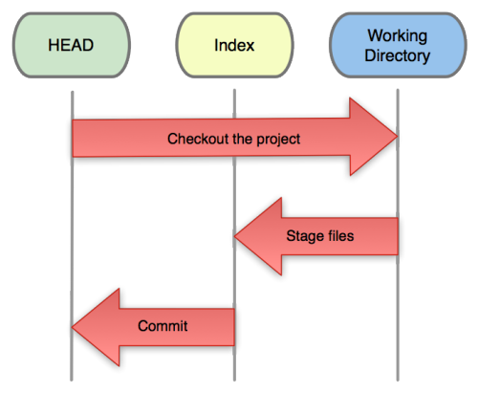
GETTING STARTED
GIT is a version control system for tracking changes in computer files and coordinating work on those files among multiple people.
Three trees of GIT:
The HEAD
last commit snapshot, next parent
Index
Proposed next commit snapshot
Working directory
Sandbox

Slide 16
WORKFLOW OF GIT
Init a repo – To initialize the repository in GIT : Git init
Edit files
Stage the changes
Review your changes
Commit the changes

Slide 17
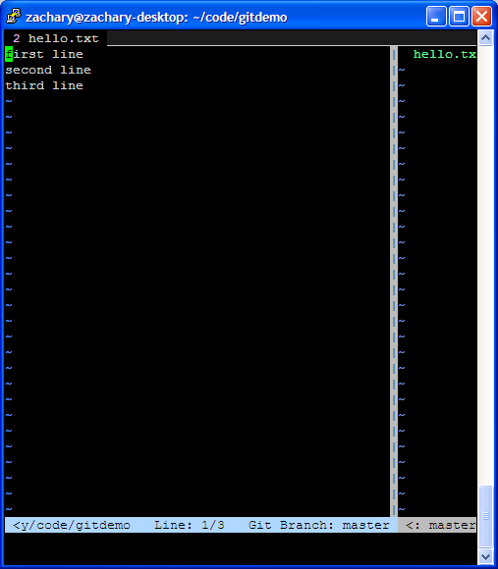
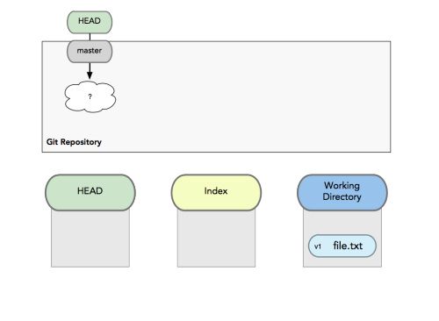
GETTING STARTED
A basic workflow
Edit files
Stage the changes
Review your changes
Commit the changes
Use your favorite editor

Slide 18
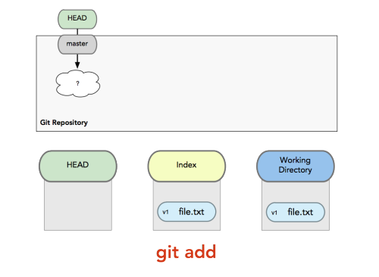
GETTING STARTED
A basic workflow
Edit files
Stage the changes
Review your changes
Commit the changes
Git add filename

Slide 19
GETTING STARTED
A basic workflow
Edit files
Stage the changes
Review your changes
Commit the changes
Git status

Slide 20
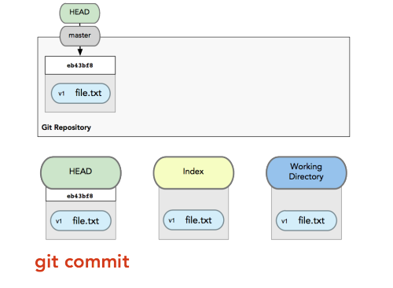
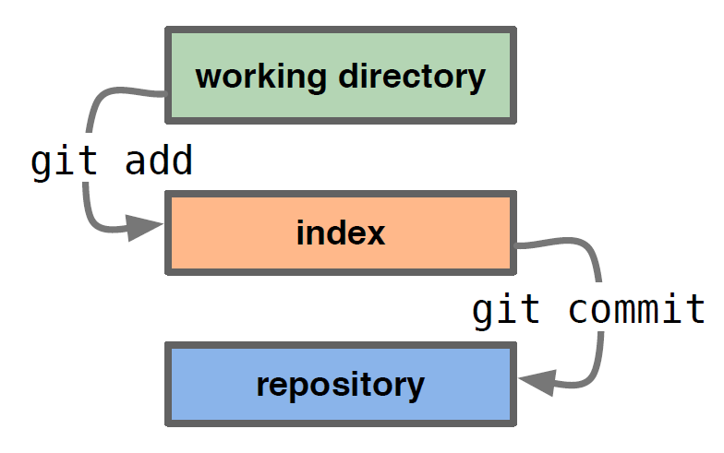
GETTING STARTED
A basic workflow
Edit files
Stage the changes
Review your changes
Commit the changes
Git commit

Slide 21
GIT Utility Commands
git gc – garbage collector (run it when the /.git/directory takes too much space).
git stash – save/restore the state of the working copy and index.
git clean – clean the working tree.
git bisect – locating which commit introduced a bug.
git cherry-pick – merging a single commit.
git revert – canceling a previous commit.

Slide 22
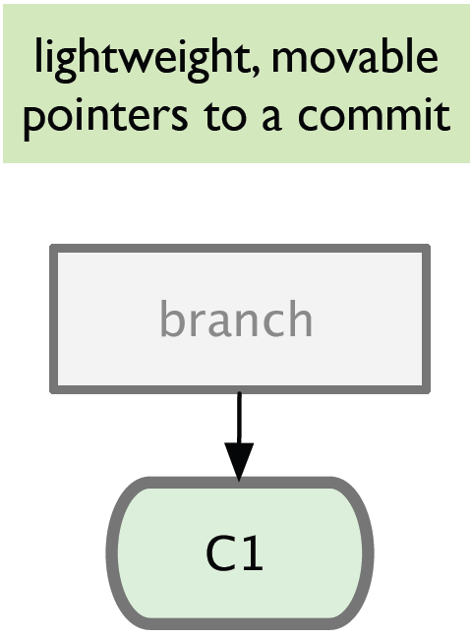
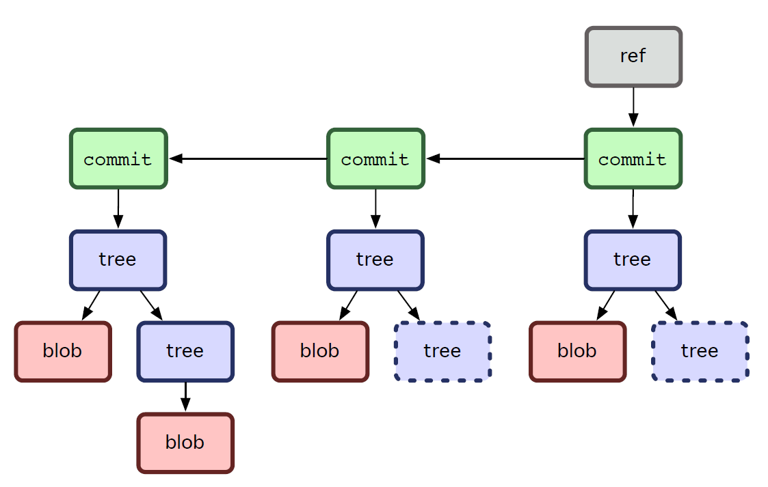
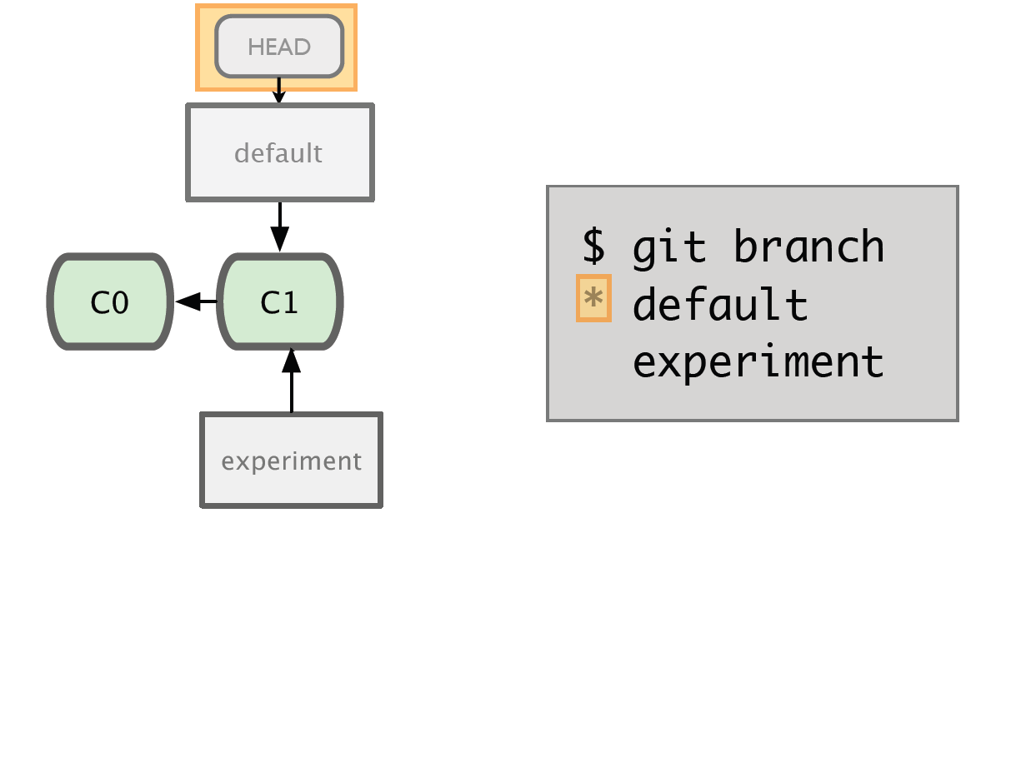
BRANCHING
It is a pointer to a commit(save the files).
The default branch name in Git is master.
‘git branch’ command used for create, rename, list and delete files.

Slide 23
USAGE
git branch – List all of the branches in your repository.
git branch <branch> – To create a new branch called <branch>.
git branch -d <branch> – To delete the branch.
git branch -m <branch> – To rename the current branch.
git branch –merged – To display all branches that are already merged.
git branch –a –color – It will be shown in appropriate colors to all branches.

Slide 24
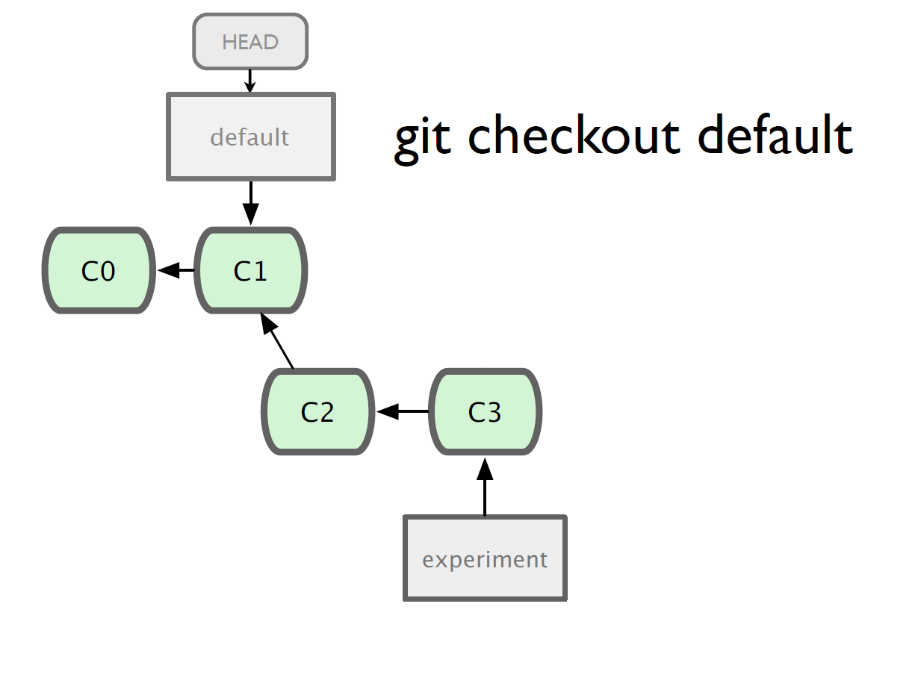
USAGE
Git checkout
lets you navigate between the
branches created by git branch.

Slide 25
MERGE
Combining one ore more branches into the current branch.
Allows changes from other branches to be integrated into the current work history
Merge only changes the workspace.
If we commit in branch, other branches not affected
Features
Fast Forward Merge
3 way Merge

Slide 26
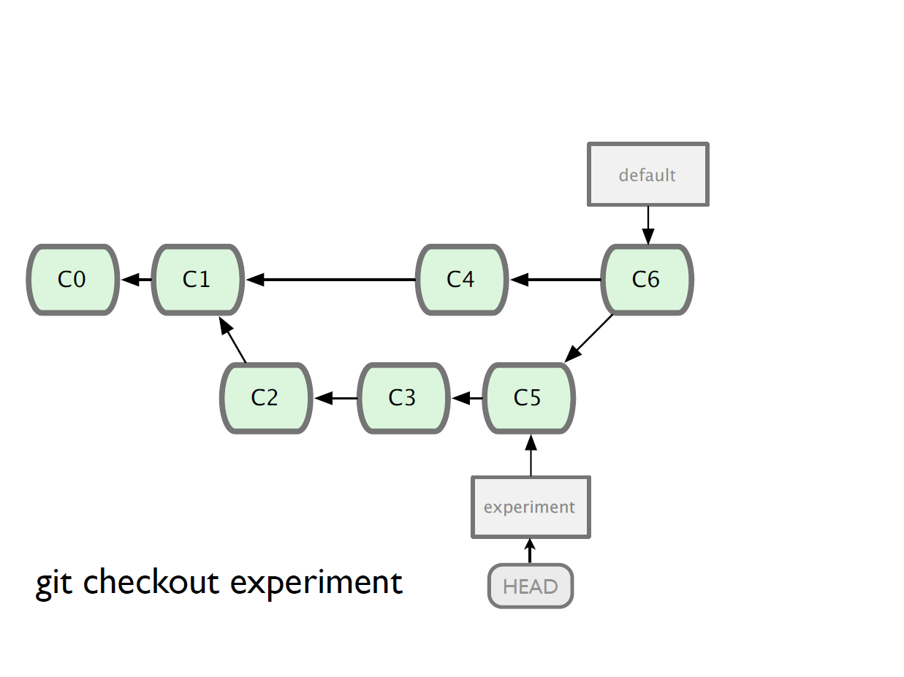
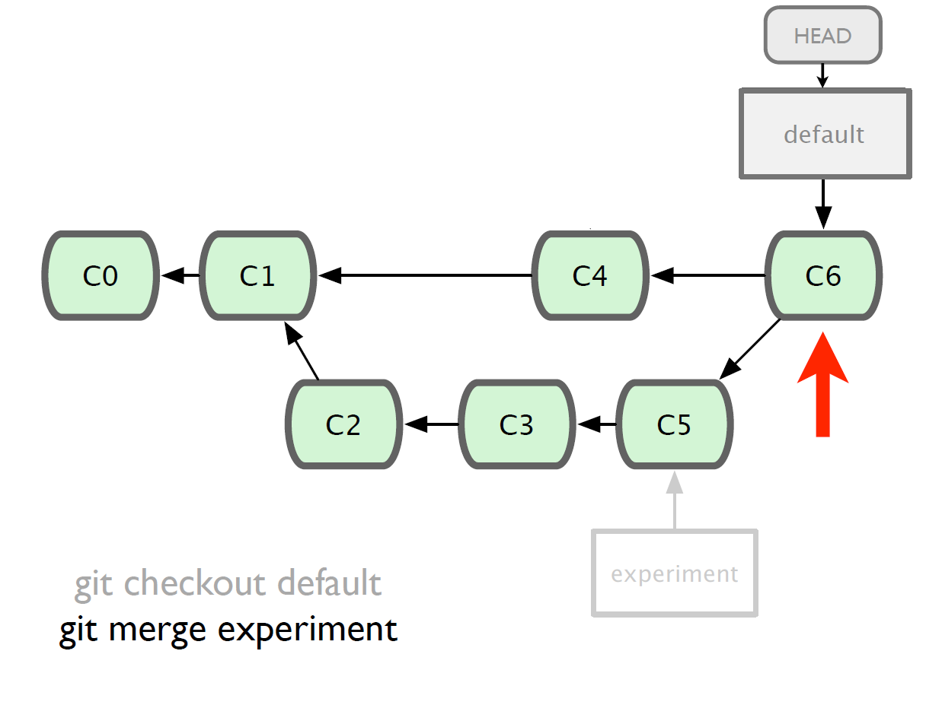
MERGING
EXAMPLE
Adding new branch to experiment

Slide 27
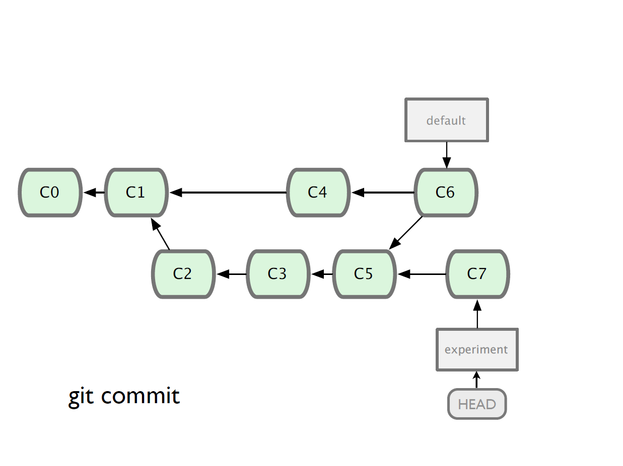
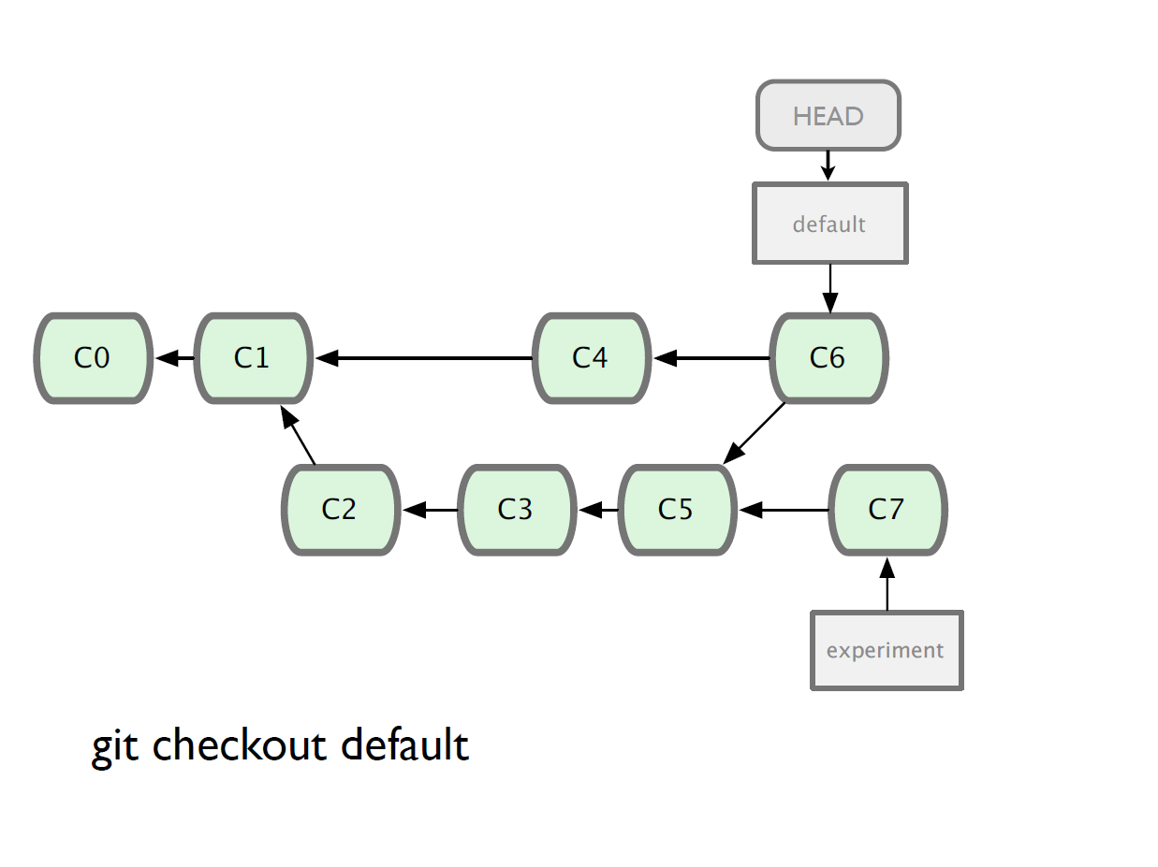
MERGING
Committing the branch to repository
Finally it navigates all the branches in directory.

Slide 28
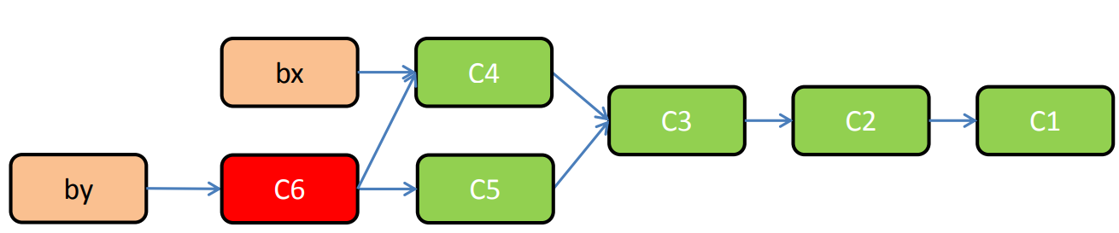
MERGING-CONFLICTS
When merging, if there are conflicts - need to solve them.
After solving, need to “add” the changes and commit the merged workspace.

Slide 29
WORKFLOW WITH LOCAL FILE SYSTEM
Pros
Simple
Support existing access control
NFS enabled
Cons
Public share is difficult to set up
Slow on top of NFS

Slide 30
WORKFLOW WITH GIT
Pros
Fastest protocol
Allow public anonymous access
Cons
Lack of authentication
Difficult to set up

Slide 31
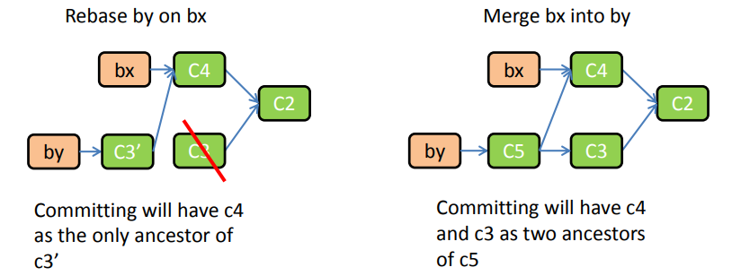
REBASE
Instead of merging, replays set of changes on top of another branch.
Affects the “rebased” branch only.
Very useful to remove history clutter.
Simple rule, use locally only and for branches which you will never share.

Slide 32
Intro to GitHub
GitHub is a Git repository hosting service, but it adds many of its own features.
GitHub provides a Web-based graphical interface.
- UI, documentation, bug tracking, feature requests, pull requests & more!
It also provides access control and several collaboration features.
It offers all of the distributed version control and source code management (SCM)
It is Founded in 2008.
Also has an Enterprise Edition for Business.

Slide 33
Installation of Git
For windows :https://git-scm.com/download/win
For Mac : https://git-scm.com/download/mac
For Linux
- Linux (Debian) - Command: sudo apt-get install git
- Linux (Fedora) - Command: sudo yum install git
To access git repo we can use CMD ,GitHub, Bit Bucket
Create one account in GitHub.

Slide 34
Tools for Git
After installation, We have tools to run git like Git CMD, Git Bash, Git GUI and GitHub.
Git CMD - Command Line prompt is the command-line interpreter on Windows operating systems. When you install git on windows and you are used to using command line, one uses cmd to run git commands.
Git Bash - Bash is a Unix shell and command language, and is the default shell on Linux, Ubuntu and Mac. The git which runs on the terminal of any Linux device is known as git bash.
Git GUI - Provides a Graphical user interface to run the git commands.
GitHub - Web-based Git version control repository hosting service.

Slide 35
Git Commands
Git init
Git clone url
Git status
Git add [file name]
Git add --all
Git commit
Git commit –m “add”
Git branch [branch name]
Git branch
Git branch –D [branch name]
Git Checkout [branch name]
Git push
Git pull
Git merge [branch name]
To initialize the repo in local repository
It copy the remote repo files from GitHub to local repo
It shows our history like commits, stage files, deleted files
Adds the file to stage area
It add all the files to staging area
To save the files from staging area to local repo
To save the file with some message related to that file
To create new branch in local repo
It displays all branches in local repo
To delete the branch in local repo
To change one branch to another branch
To push our local repo to remote repo
To pull from remote repo to local repo
To merge branch file to master file

Slide 36
Steps To Create Sample Repo
Create a local Git Repo
Create a new branch
Make and commit changes
Open a Pull Request
Checkout Repository
Merge your Pull Request

Slide 37

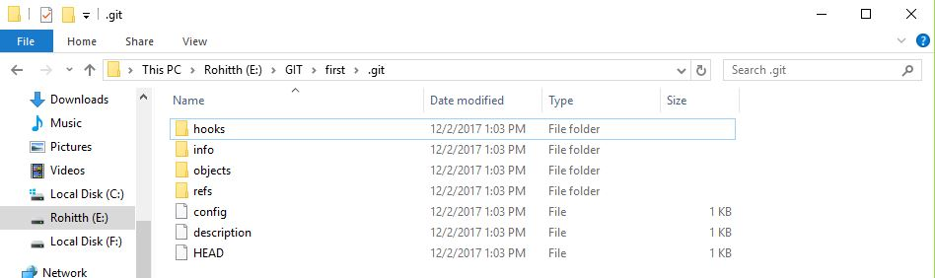
Initialize a Repository
To initiate a new repository – git init
Then it creates one folder as our Repository.

Slide 38
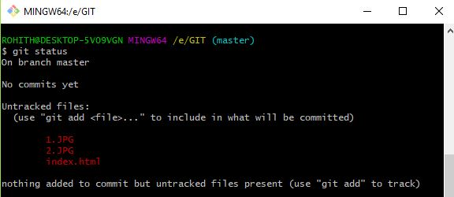
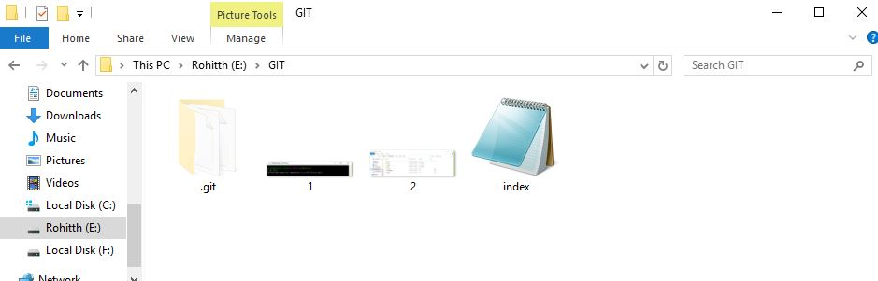
To View our Files
Shows the working repo files and commits – git status
For example, these are the files I’m created in work space.
Repository

Slide 39
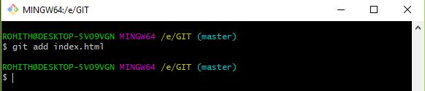
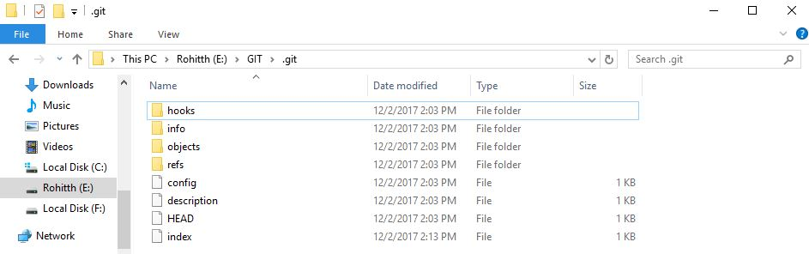
Adding Files to Local Repo
To add files to repo - git add
I added “index” to the Staging area.

Slide 40
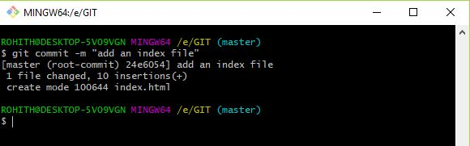
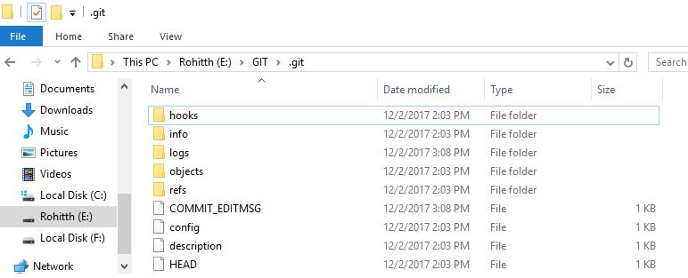
Committing Files
Here I’m changing the text in index file as “add an index file”
To save the file in repo – git commit –m
Then the file name changes from Index to COMMIT_EDITMSG

Slide 41
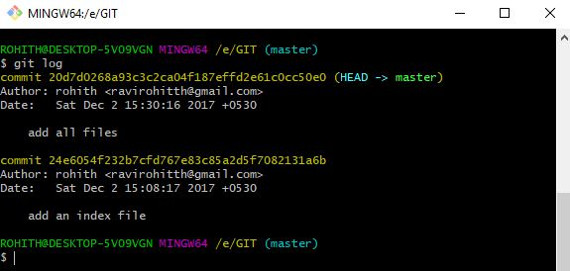
Display our Commits
I added one more file to repo and I committed to local repo
To show all our commits – git log

Slide 42
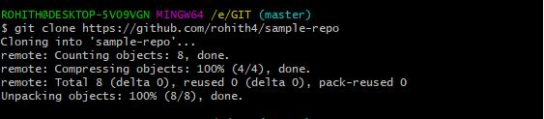
Cloning files to remote repo
To push our local repo to remote
- git clone https://github.com/rohith4/sample-repo/

Slide 43
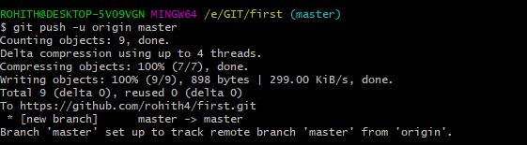
Pushing files to Remote Repo
push our local commits to our origin repo or remote repo - git push -u origin master
Pushes the changes in your local repository up to the remote repository you specified as the origin

Slide 44
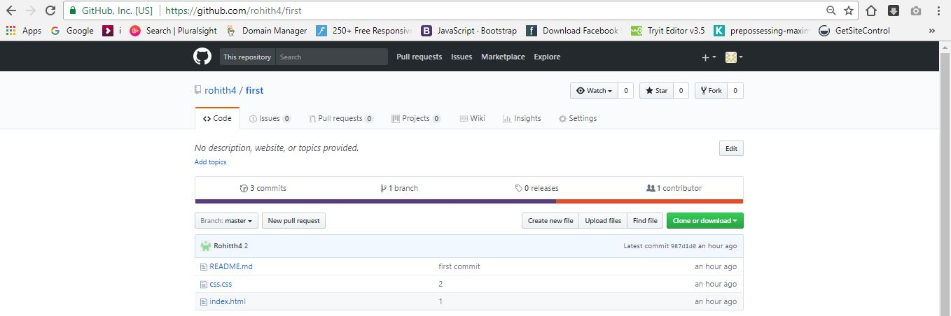
Remote Repo of Git

Slide 45
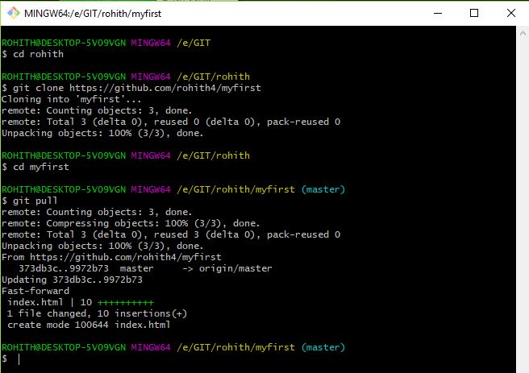
Pull Repo from remote Repo – git pull
Pull files
Here I pulled repository from remote repo to local repository

Slide 46
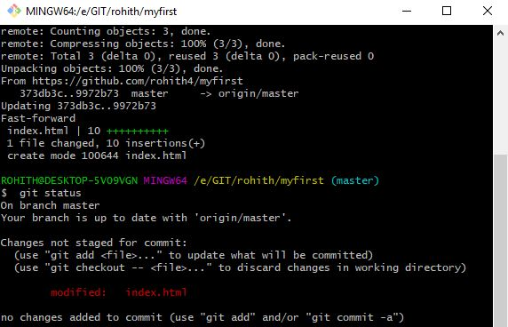
Status of our local Repo
Open the Local Repo of git.
Add some data to that file and save the file.
To check the status of the file – git status
(there it shows modified index.html)

Slide 47
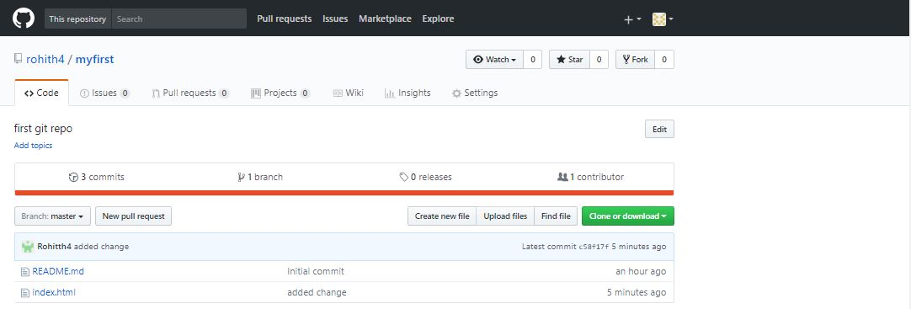
Adding another file to repo
To add more files to local repository – git add – A
Commit the current file to local repo
Push the local repo to remote repo that is git repo

Slide 48
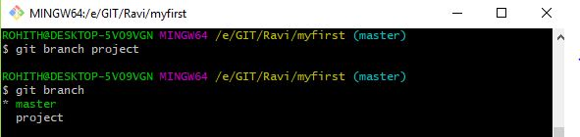
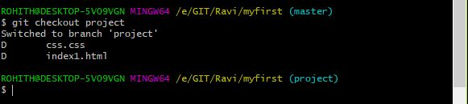
To create a new branch – git branch <branch name>
Branching
To check branches in local repo – git branch
To change master branch to another branch – git checkout <branch name>

Slide 49
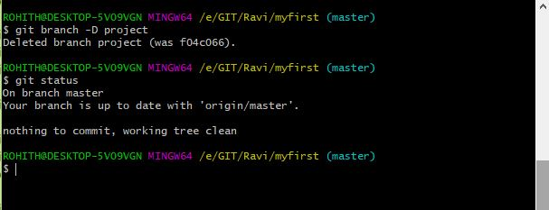
To delete branch – git branch –D <branch name>
Delete Branch

Slide 50

To checkout branch – git checkout master
Checkout Branch Files
This command shows all branches, commits and changes one branch to master branch.

Slide 51
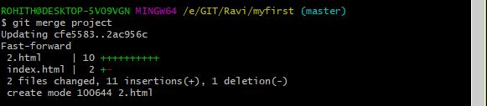
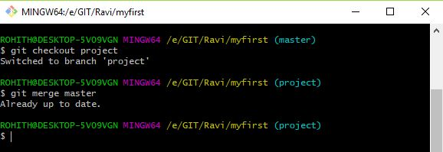
To merge the branch to master branch – git merge <branch name>
Merging two branches
To check if the branch is merged to master – git checkout <branch name>
It comes to another branch “project”
Then give “git merge master” it shows already done

Slide 52
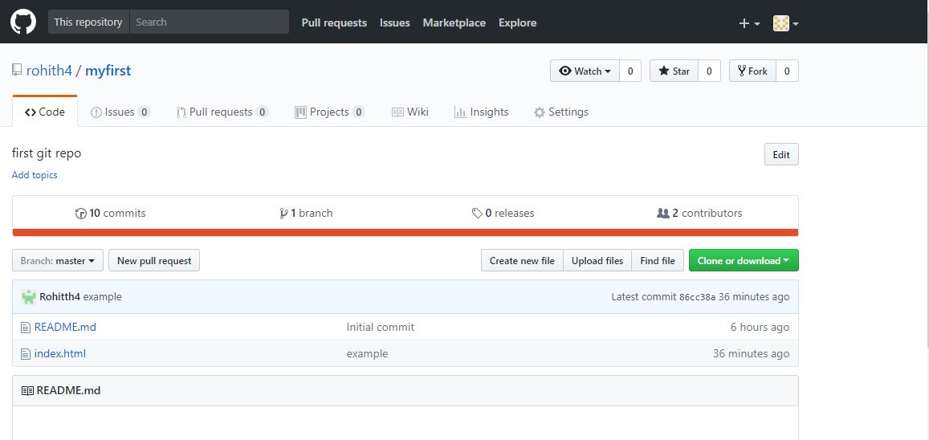
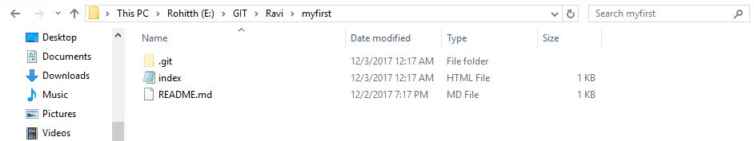
Local Repository
Remote Repository

Slide 53
CONCLUSION
Version control is a great asset to most workflows where it is important to track changes as well as provide a repository of files for others to access.
DVCS have gained a great deal of attention in recent years given the explosion of open source projects.
DVCS provides benefits that greatly align themselves with modern projects and workflows.
CVCS can assist your team in making the transition.

Slide 54
THANK YOU

